Slide 1
New-ish Designs for Clinical Trials
Dave Harrington
Dana-Farber Cancer Institute
Harvard University

Slide 2
Acknowledgements/COI
Examples contributed by
Cyrus Mehta, CYTEL
Lorenzo Trippa, Dana-Farber and Harvard
Mithat Gonen, MSKCC
Conflicts
None to report

Slide 3
Outline
Some general perspectives
Bayesian adaptive randomization
Basket trials
Flexible/Adaptive Designs
Reproducibility
Data sharing

Slide 4
Scientific Issues driving new designs
A deeper understanding of biology for many diseases has led to an increase in the development of new drugs.
In many cases, these drugs may work better in patients with particular disease signatures.
Drugs may work across phenotypic subtypes of disease that have similar genetic or molecular signatures
The design of phase III trials is as much art/intuition as science.
Too many phase III trials fail because of `poor’ design choices – wrong patients, in appropriate target treatment effects, insufficient sample size.

Slide 5
Ecological Issues
Increased concern about reproducibility, especially in the results of post-hoc analyses
Rapid development of new agents sometimes mean trial designers are working without sufficient information on
Subgroups
Likely treatment effects
Adherence

Slide 6
Bayesian Adaptive Randomization (BAR)
Simple idea
Use accumulating information to adjust randomization fraction
Complicated execution
Modeling assumptions
Analysis is complex
Logistic support is essential, since data are continually updated

Slide 7
Prior assumption about distribution of response probabilities
Data during trial on response (x = 1) and non-response (x = 0)
Update assumption of response probabilities (posterior distribution)

Slide 8
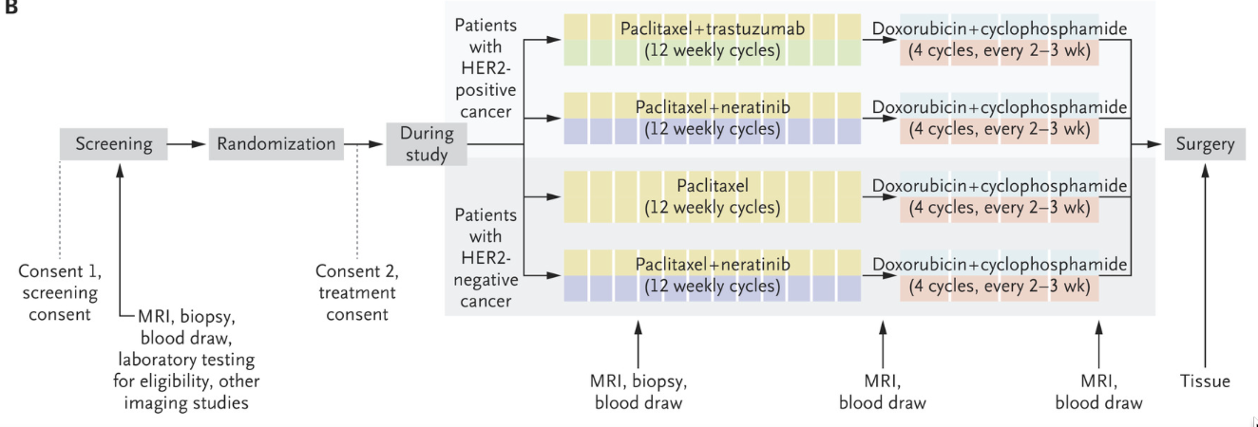
I-SPY 2 (N Engl J Med 2016; 375:11-22)

Slide 9
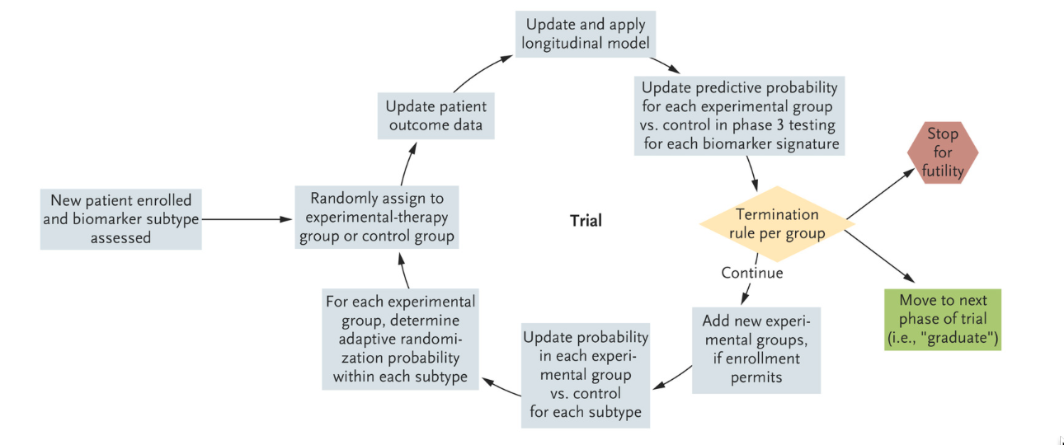
I-SPY 2 (N Engl J Med 2016; 375:11-22)

Slide 10
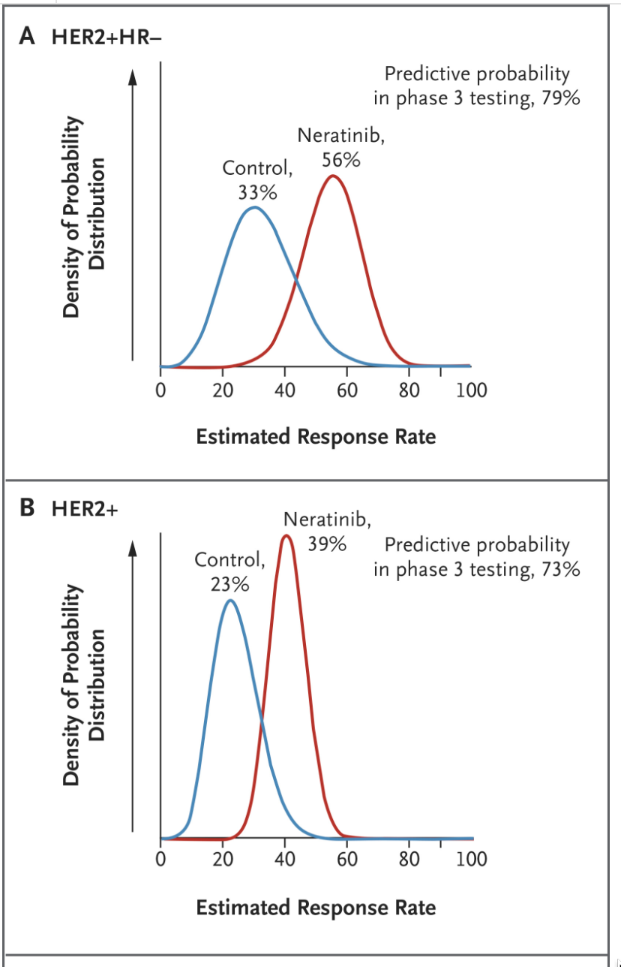
I-SPY 2 (N Engl J Med 2016; 375:11-22)

Slide 11
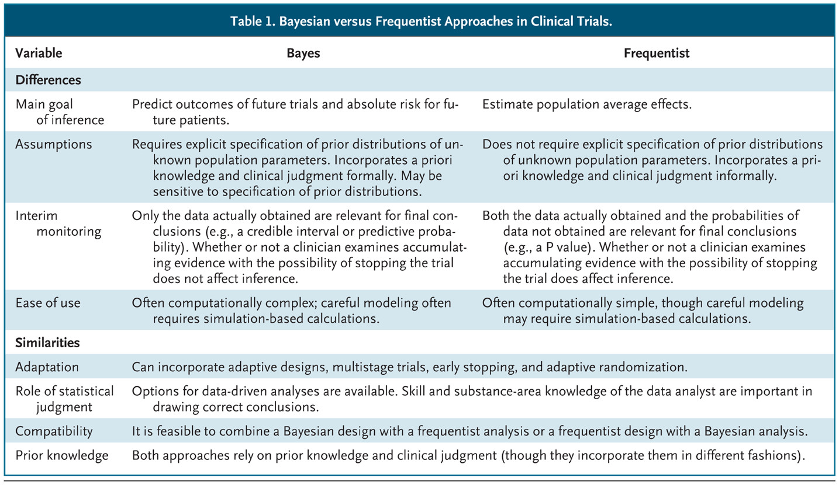

Harrington D, Parmigiani G. N Engl J Med 2016;375:7-9.
Bayesian versus Frequentist Approaches in Clinical Trials.

Slide 12
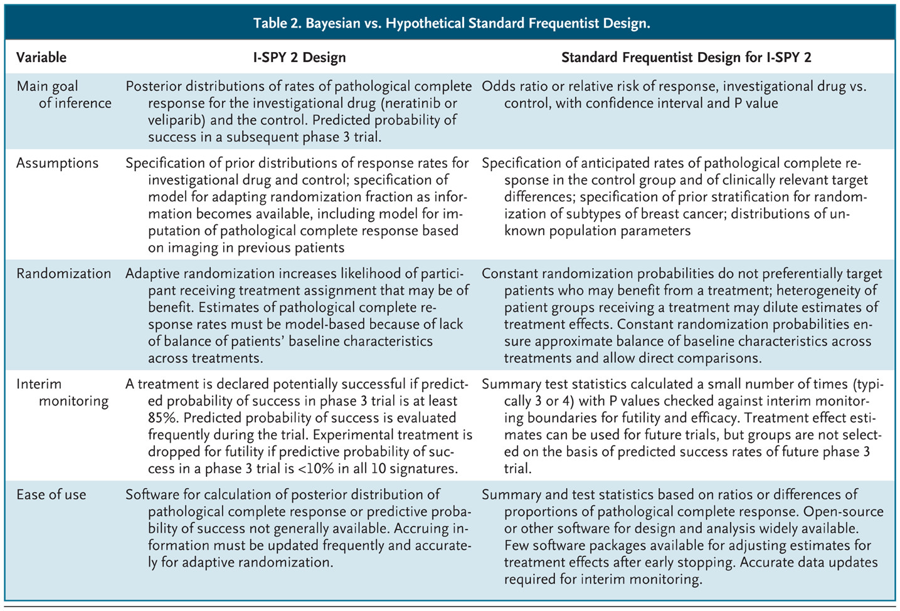
Harrington D, Parmigiani G. N Engl J Med 2016;375:7-9.
Bayesian vs. Hypothetical Standard Frequentist Design.

Slide 13
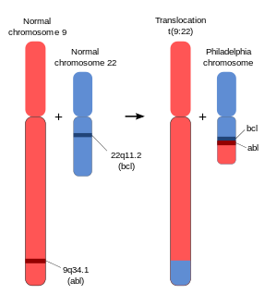
Basket trials
Basket trials test therapies in diseases that are
Phenotypically different
Similar in molecular or genetic signatures
Most often used in Phase 2 trials in cancer
Example: BCR-ABL Translocation
Parts of two chromosomes (9 and 22) switch places
Results in a “fusion gene”: juxtaposition of ABL1 gene (9q34) to the BCR gene (22q11)

Slide 14
Using the Traditional Design in Basket Trial
12 Patients
>1 Response
23 More Patients
>5 Response
≤1 Response
Stop
Promising Drug
≤5 Response
Unpromising Drug
12 Patients
>1 Response
23 More Patients
>5 Response
≤1 Response
Stop
Promising Drug
≤5 Response
Unpromising Drug
12 Patients
>1 Response
23 More Patients
>5 Response
≤1 Response
Stop
Promising Drug
≤5 Response
Unpromising Drug
12 Patients
>1 Response
23 More Patients
>5 Response
≤1 Response
Stop
Promising Drug
≤5 Response
Unpromising Drug
12 Patients
>1 Response
23 More Patients
>5 Response
≤1 Response
Stop
Promising Drug
≤5 Response
Unpromising Drug
12 Patients
>1 Response
23 More Patients
>5 Response
≤1 Response
Stop
Promising Drug
≤5 Response
Unpromising Drug

Slide 15
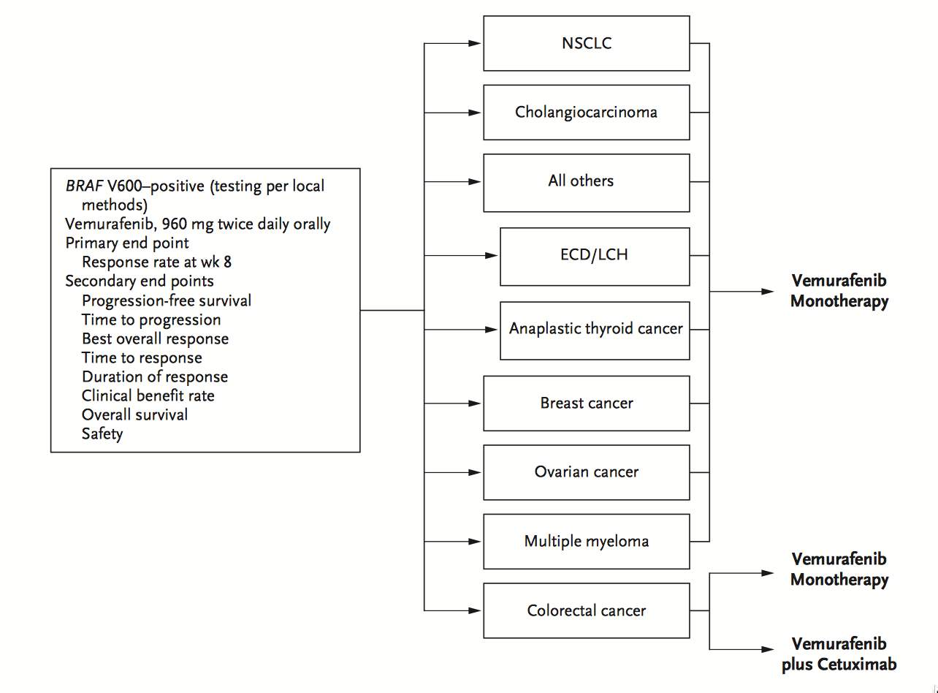
Hyman, et al. (NEJM 373:8, Aug 20, 2015)

Slide 16
Hyman, et al. (NEJM 373:8, Aug 20, 2015)
“BRAF V600 appears to be a targetable oncogene in some, but not all, nonmelanoma cancers.
Preliminary vemurafenib activity was observed in non–small-cell lung cancer and in Erdheim–Chester disease and Langerhans’-cell histiocytosis.
The histologic context is an important determinant of response in BRAF V600–mutated cancers.”

Slide 17
Aggregation Design (M. Gonen, et al., MSKCC working paper)
Stage 1
Allocate a (modest) number of patients in each basket
Evaluate if response rates are heterogenous across baskets to determine if baskets should be treated as independent or aggregated
Apply a futility rule to individual baskets or the aggregated basket, depending on assessment of heterogeneity
Stage 2
Continue allocating patients to the aggregated basket and use a one-sample test for efficacy
OR
Continue allocating patients only to selected baskets and test for efficacy using many one-sample tests, adjusting for multiple testing

Slide 18
Bayesian Basket Designs, Trippa & Alexander, JCO 2017.
Notes:
In this Bayesian Basket example, there are three different arms on the same trial depicted. The leftmost arm starts out as a TB trial based on the investigators’ weighing of prior data and stays that way throughout the trial. The middle arm starts out rather uncertain about the biomarker-effect linkage but then learns that the signal is limited to the biomarker-positive population only. Finally, the rightmost arm starts with preliminary evidence that the biomarker-positive group would uniquely benefit from the therapy, but during the course of the trial, it becomes evident that all patients might benefit.

Slide 19
Adaptive, flexible designs
Traditional Design: fix the sample size in advance and only perform one efficacy analysis after all subjects have been enrolled and evaluated.
Flexible Design: monitor the accruing efficacy data at administratively convenient intervals and make important decisions concerning the future course of the study along the way.
Flexible designs more appealing to pharma than academic trials, but can be useful in both settings.

Slide 20
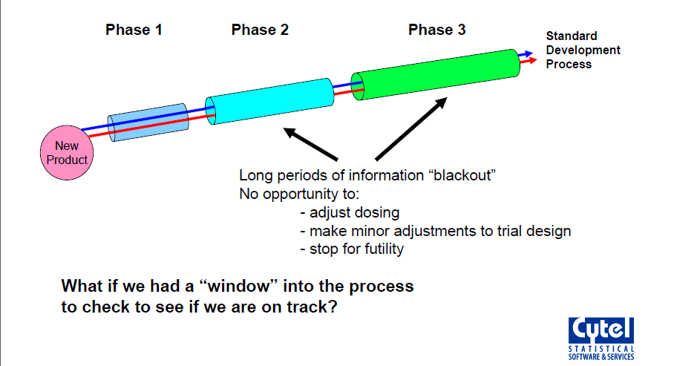
Traditional Clinical Development Process

Slide 21
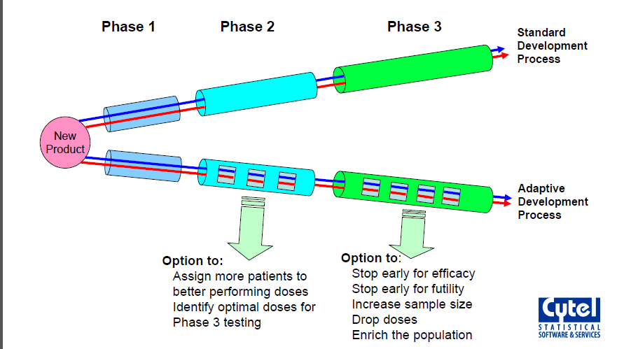
Adaptive Clinical Development Process

Slide 22
Event Driven Trial to Detect HR=0.75
Enroll 7000 patients over 4 years; and follow for 1 more year until 530 CV events obtained
Given 3.25% events/year on placebo, trial has:
91% power to detect HR=0.75 (25% risk reduction)
73% power to detect HR=0.8 (20% risk reduction)
Possible to recover lost power if HR=0.8?

Slide 23
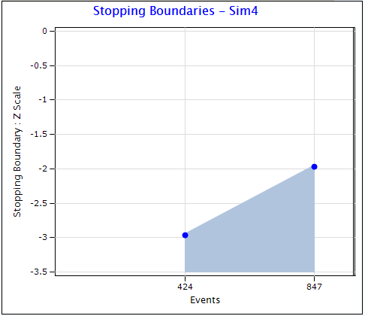
Option 1: Large Group Sequential Trial
11,000 patients and 847 events over 5 years provides 91% power to detect HR=0.8
Group sequential boundary for early stopping
Early stopping probability:
27% if HR=0.8
50% if HR=0.75
Problem: Only 1.5 years of average follow-up if early stop

Slide 24
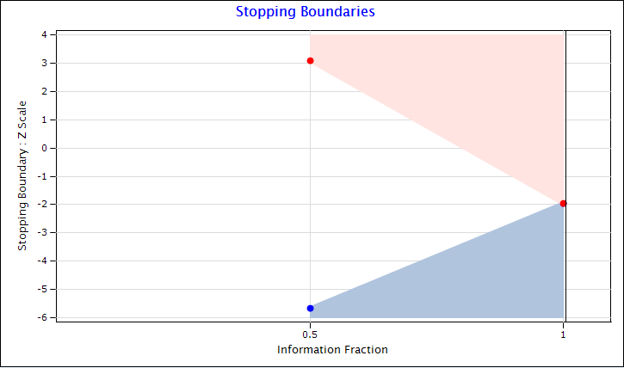
Option 2: Promising Zone Design
Start small: 7000 patients and 530 events
Increase by 50% if interim results are promising
Promising zone is defined by conditional power
Unfavorable:
CP<50%
Promising: 50%≤CP<90%
Favorable:
CP>90%
Unfavorable Zone
Promising Zone
Favorable Zone

Slide 25
Design Optimistically: Assume HR=0.75
Operating Characteristics if in Truth Risk Reduction is 20% (HR=0.8)
Zone | P(Zone) | Power |  | Sample Size |  | Study Duration
 |  | NonAdapt | Adaptive | NonAdapt | Adaptive | NonAdapt | Adaptive
Unfav | 24% | 38% | 38% | 7000 | 7000 | 4.9 | 4.9
Prom | 36% | 74% | 90% | 7000 | 10500 | 4.9 | 5.7
Fav | 40% | 95% | 95% | 7000 | 7000 | 4.9 | 4.9
Operating Characteristics if in Truth Risk Reduction is 25% (HR=0.75)
Zone | P(Zone) | Power |  | Sample Size |  | Study Duration
 |  | NonAdapt | Adaptive | NonAdapt | Adaptive | NonAdapt | Adaptive
Unfav | 12% | 57% | 57% | 7000 | 7000 | 5 | 5
Prom | 28% | 87% | 98% | 7000 | 10500 | 5 | 5.8
Fav | 60% | 99% | 99% | 7000 | 7000 | 5 | 5

Slide 26
Statistical Issues with Adaptive Designs
For a regulatory filing, must maintain strong control of type-1 error
Two sources of error inflation in these examples
due to unblinded sample size re-estimation
due to enrichment by subgroup selection
Although the trial is expanded only if the IA shows promise of superiority:
Actual interim decision should only be conveyed on need to know basis (to drug supply and IVRS teams)
Investigators may be told only that this adaptive design has a maximum sample size of xxx patients and possibility of re-powering at IA
Use a double blind design if possible to avoid operational bias

Slide 27
Operational and Bias Issues
All design details are included in DMC charter
DMC buys into design at the kick-off meeting, but reserves right to exercise clinical judgment
Although the trial is expanded only if the IA shows promise of superiority:
Actual interim decision should only be conveyed on need to know basis (to drug supply and IVRS teams)
Investigators may be told only that this adaptive design has a maximum sample size of xxx patients and possibility of re-powering at IA
Use a double blind design if possible to avoid operational bias

Slide 28
Data sharing for complex designs
As a trial designer, I would like to know what happened in previous trials.
Information richer than overall summary statistics would be most helpful
Patient mix, including correlation among baseline characteristics
Time-dependent behavior of the trial
Help may be on the way

Slide 29
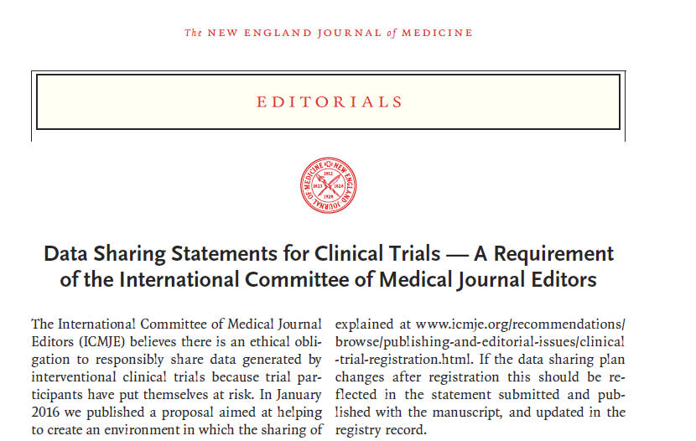
June 8, 2017

Slide 30
ICMJE Policy (NEJM June 8, 2017)
“1. As of July 1, 2018, manuscripts submitted to ICMJE journals that report the results of clinical trials must contain a data sharing statement as described below.
2. Clinical trials that begin enrolling participants on or after January 1, 2019, must include a data sharing plan in the trial’s registration. The ICMJE’s policy regarding trial registration is explained at www.icmje.org/recommendations/browse/publishing-and-editorial-issues/clinical-trial-registration.html. “

